Slide 1

Pituitary gland
Dr/Ebtihal Kamal

Slide 2
Pituitary gland
Thepituitary gland, orhypophysis , is located at the base of the brain just belowthe hypothalamus. It is composed of two functionally and anatomically distinct lobes
• Neurohypophysis (posterior pituitary)
• Adenohypophysis (anterior pituitary)

Slide 3
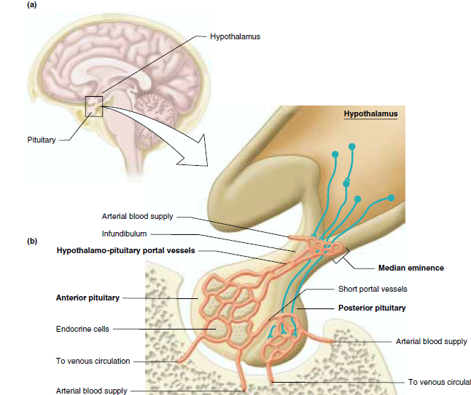

Slide 4
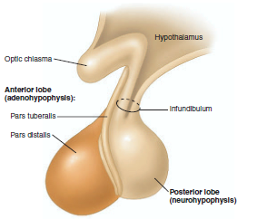

Slide 5
The neurohypophysis is derived embryonically from nervous tissue. It is essentially an outgrowth of the hypothalamus produce primarily antidiuretic hormone (ADH) and oxytocin. These hormones are then transported down the axons to the neurohypophysis and stored. Much like neurotransmitters, the hormones are released in response to the arrival of action potentials at the neuron terminal.

Slide 6
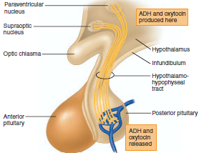

Slide 7
The adenohypophysis
Unlike the neurohypophysis, which releases
hormones originally synthesized in the hypothalamus, the adenohypophysis synthesizes its own hormones in specialized groups of cells. Similar to neurohypophysis, however, the release of these hormones into the blood is regulated by the hypothalamus.

Slide 8
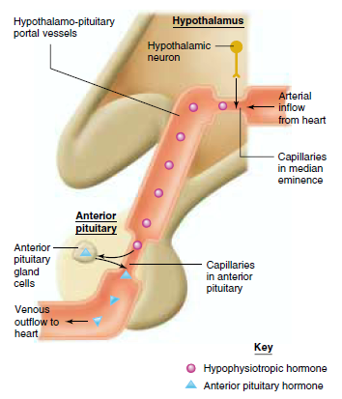

Slide 9
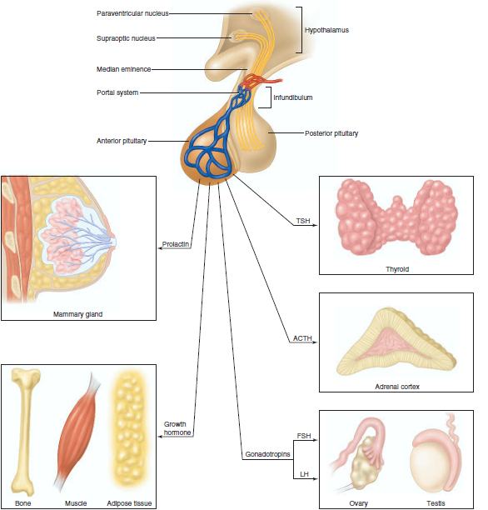

Slide 10
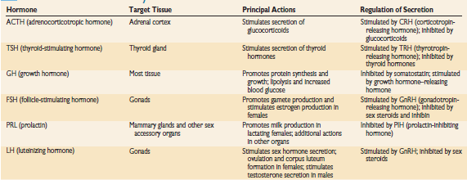

Slide 11
Negative feedback control of hormone release
In many cases, hormones released from the adenohypophysis are part of a three-hormone axis that includes the:
• Hypothalamic hormone
• Adenohypophyseal hormone
• Endocrine gland hormone
The hypothalamic hormone stimulates or inhibits the secretion of the adenohypophyseal hormone. The trophic hormone from the adenohypophysis then stimulates the release of a hormone from another endocrine gland. This final endocrine gland hormone not only carries out its effects on its target tissues.

Slide 12
negative feedback effect on the release of the hypothalamic and/or adenohypophyseal hormones. In this way, this final hormone regulates its own release This process is referred to as long-loop negative feedback
The adenohypophyseal hormone may also exert a negative feedback effect on the hypothalamic hormone and limit its own release. This process is referred to as short-loop negative feedback

Slide 13
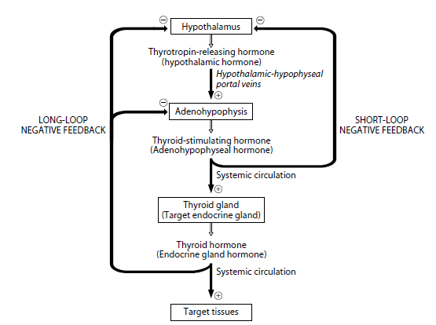

Slide 14
Hormones of the neurohypophysis
Antidiuretic hormone (ADH) also referred to as vasopressin has two major effects, both of which are reflected by its names:
(1) antidiuresis (decrease in urine formation by the kidney); and
(2) vasoconstriction of arterioles.
Antidiuretic hormone promotes the reabsorption of water from the tubules of the kidney, acts on the collecting ducts and increases the number of water channels, which increases the diffusion for water. This results in the body’s conservation of water and the production of a low volume of concentrated urine.

Slide 15
This effect of ADH on the kidney occurs at relatively low concentrations. At higher concentrations, ADH causes constriction of arterioles which serves to increase blood pressure

Slide 16
Antidiuretic hormone secretion is regulated by several factors:
• Plasma osmolarity
• Blood volume
• Blood pressure
• Alcohol

Slide 17
The primary factor that influences ADH secretion is a change in Plasma osmolarity
Osmoreceptors in the hypothalamus are located in close proximity to the ADH-producing neurosecretory cells. Stimulation of these osmoreceptors by an increase in plasma osmolarity results in stimulation of the neurosecretory cells; an increase in the frequency of action potentials in these cells; and the release of ADH from their axon terminals in neurohypophysis

Slide 18
Hypothalamic osmoreceptors have a threshold of 280 mOsM. Below this value, they are not stimulated and little or no ADH is secreted. Maximal ADH levels occur when plasma osmolarity is about 295 mOsM.

Slide 19
Other factors regulating ADH secretion include blood volume and blood pressure. A decrease in blood volume
of 10% or more causes an increase in ADH secretion sufficient to cause vasoconstriction as well as antidiuresis. A decrease in mean arterial blood pressure of 5% or more also causes an increase in ADHsecretion. The resulting water conservation and vasoconstriction help increase blood volume and blood pressure back to normal

Slide 20
the effect of blood pressure on ADH secretion may be correlated to the increase in secretion that occurs during sleep, when blood pressure decreases. The result is the production of a low volume of highly concentrated urine that is less likely to elicit the micturition (urination) reflex and interrupt sleep.
alcohol
inhibits the secretion of ADH, thus allowing for loss of water from the kidney. lead to excessive water loss and dehydration instead of volume expansion.

Slide 21
The secretion of oxytocin is regulated by reflexes elicited by cervical stretch and by suckling
. Normally, as labor begins, the fetus is positioned head down. This orientation exerts pressure on the cervix and causes it to stretch. Sensory neurons in the cervix are thus activated to transmit signals to the hypothalamus, which will stimulate the release of oxytocin from the neurohypophysis. This hormone then enhances uterine contraction which causes further pressure and stretch of the cervix, additional oxytocin release, and so on, until pressure has built up adequately so that delivery can take place.

Slide 22
In contrast, the release of oxytocin from the neurohypophysis may be inhibited by pain, fear, or stress.

Slide 23
Oxytocin
stimulates:
• Contraction of uterine smooth muscle
• Contraction of myoepithelial cells
During labor, this facilitates the delivery of the fetus and, during intercourse, may facilitate the transport of the sperm through the female reproductive tract. Oxytocin also causes contraction of the myoepithelial cells Surrounding the alveoli of the mammary glands. This results in “ milk letdown
” or the expulsion of milk from deep within the gland into the larger ducts from which the milk can be obtained more readily by the suckling infant.

Slide 24
Hormones of the adenohypophysis
1)The gonadotropins, follicle-stimulating hormone (FSH)and luteinizing hormone,(LH)
exert their effects on the gonads (ovaries in the female and testes in the male).
Taken together, the gonadotropins stimulate the gonads to:
• Produce gametes (ova and sperm)
• Secrete sex hormones (estrogen, progesterone, and testosterone

Slide 25
2)Thyroid-stimulating hormone (TSH, thyrotropin) regulates the growth and metabolism of the thyroid gland. it stimulates synthesis and release of the thyroid hormones, T3 and T4. The release of TSH from the thyrotrope cells of the adenohypophysis is induced by thyrotropin-releasing hormone (TRH)

Slide 26
3)Adrenocorticotropichormone(ACTH, adrenocorticotropin) stimulates growth and steroid production in the adrenal cortex. It stimulates secretion of cortisol and other glucocorticoids involved with carbohydrate metabolism. The release of ACTH from the adenohypophysis is influenced by more than one factor. Corticotropin-releasing hormone (CRH) from the hypothalamus stimulates the secretion of ACTH.ACTH secretion follows a diurnal pattern, with a peak in the early morning and a valley in the late afternoon.

Slide 27
5)Growth hormone (GH, somatotropin) is one of the few hormones that exerts its effects on organs and tissues throughout the body. This hormone is essential for normal growth and development of the skeleton as well as visceral, or soft, tissues from birth until young adulthood.

Slide 28
Growth hormone also has many metabolic actions in the body:
Protein metabolism
• Increase in tissue amino acid uptake
• Stimulation of protein synthesis
Lipid metabolism
• Increase in blood fatty acids
• Stimulation of lipolysis
• Inhibition of lipogenesis
Carbohydrate metabolism
• Increase in blood glucose
• Decrease in glucose uptake by muscle
• Increase in the hepatic output of glucose (glycogenolysis)

Slide 29
The net effects of these actions include enhanced growth due to protein synthesis; enhanced availability of fatty acids for use by skeletal muscle as an energy source; and glucose sparing for the brain, which can use only this nutrient molecule as a source of energy

Slide 30
The release of GH from the adenohypophysis is regulated by two hypothalamic hormones: growth hormone-releasing hormone (GHRH) and growth
hormone-inhibiting hormone (GHIH, somatostatin). Any factor or condition that enhances the secretion of GH could do so by stimulating or inhibiting GHRH release or by inhibiting GHIH release

Slide 31
The secretion of GH follows a diurnal rhythm with GH levels low and constant throughout the day and with a marked burst of GH secretion approximately one hour following the onset of sleep (deep or stage III and IV sleep). Other factors that stimulate GH
secretion include exercise, stress, hypoglycemia, and increased serum amino acids, particularly arginine and leucine. Factors that inhibit GH secretion include hyperglycemia and aging.

Slide 32
